Slide 1

Rajkiya Engineering College Banda
Department of Information Technology
MAJOR PROJECT PRESENTATION
SECURED AUTOMATIC QUESTION PAPER GENERATION
Under the guidance of:
Presented by:
Dr. Vibhash Yadav
Associate Professor, R.E.C. BANDA
Akash Pandey (2107340130002)
Krishna Pratap Singh (2107340130029)
Rajnish Chaube (2107340130049)
Ranjeet Singh (2107340130052)

Slide 2
Project Overview
Main Module
Automatic Question Paper Generation
Security algorithm (MD5 & SHA256)

Slide 3


Secured Automatic Question Paper Generation
Automatic Question Paper Generation
This module automates question selection. It uses predefined criteria to generate question papers.
Hashing & Security
This ensures integrity. The module hashes and secures the generated paper.
MD5 Algorithm
MD5 creates a 128-bit hash value. This is unique to the data.
SHA256 Algorithm
SHA256 generates a 256-bit hash value. SHA256 algorithm provides stronger security.

Slide 4
Module 1: Automatic Question Paper Generation
Question Selection
Automated Formatting
Custom Parameters
Select questions from a pre-existing bank.
Automate the formatting of the generated paper.
Difficulty, topic, and question types are customizable.

Slide 5
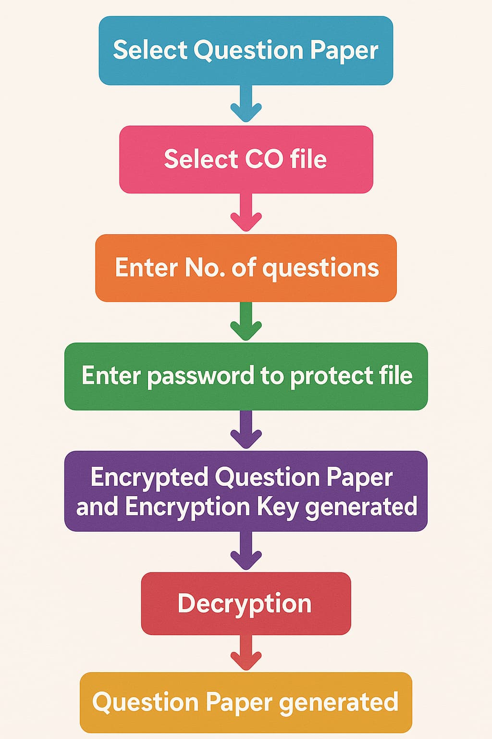
Flowchart of Module 1

Slide 6
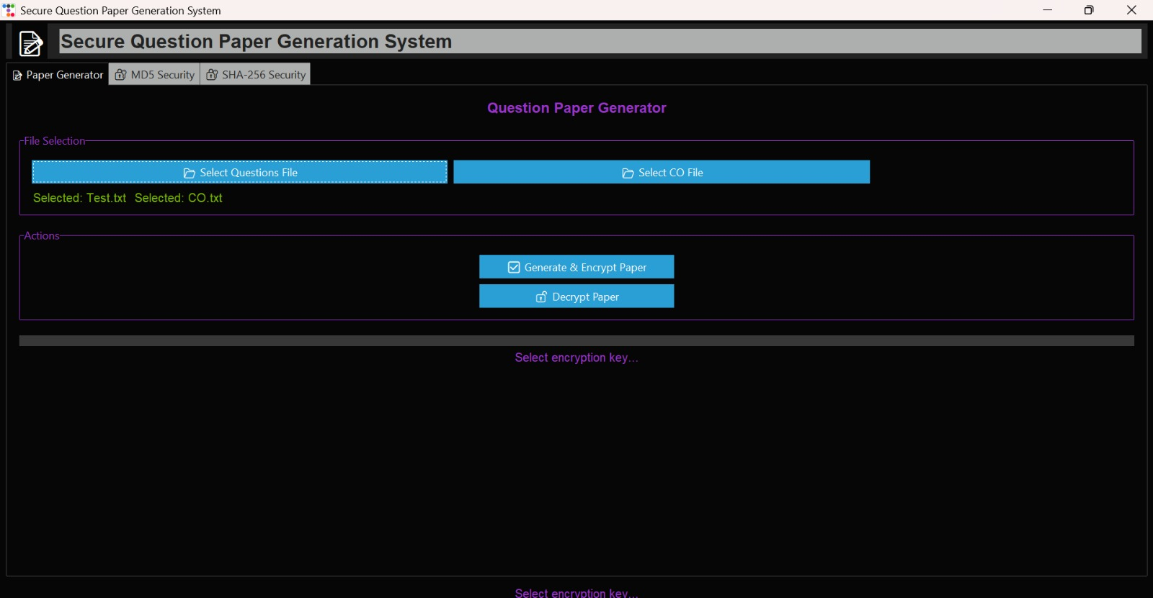



Algorithm for
Question Selection
Parameter Input
Randomization
Constraint Application
Define difficulty, topic coverage.
Ensure unique papers each time.
Balance topics and difficulty.

Slide 7
What is AES?
Advanced Encryption Standard (AES) is a symmetric block cipher used to encrypt data.
Operates on fixed-size blocks (128 bits) with key sizes of 128, 192, or 256 bits.
Widely adopted due to its security, speed, and efficiency.
Why AES in Our Project?
Ensures confidentiality of the question paper PDF before it's shared.
Prevents unauthorized access by encrypting the file with a secret key.
Only authorized recipients (e.g., professors) with the key can decrypt and read the file.
AES Benefits in Our Use Case
High security against brute-force and cryptanalysis.
Fast and efficient, suitable for encrypting large PDFs.

Slide 8
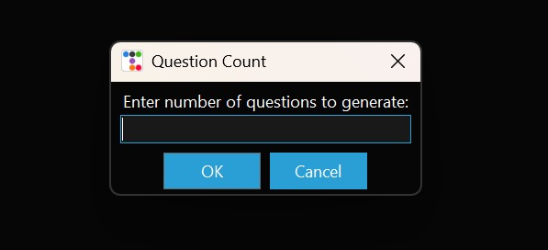
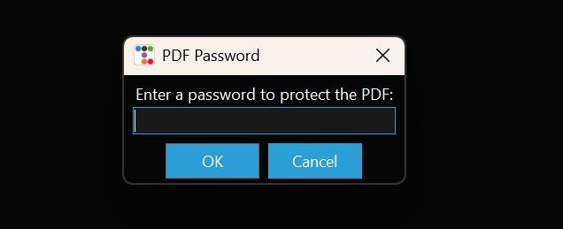
User Input for Question Count
Password for PDF Security

Slide 9
Module 2: Question Paper Security
Algorithms
1
Core Objective
2
Hashing Algorithms
MD5
SHA256
Secure distribution and prevent unauthorized access.
Focus on using MD5 and SHA256.
3
Security Focus
Prevent unauthorized access.

Slide 10
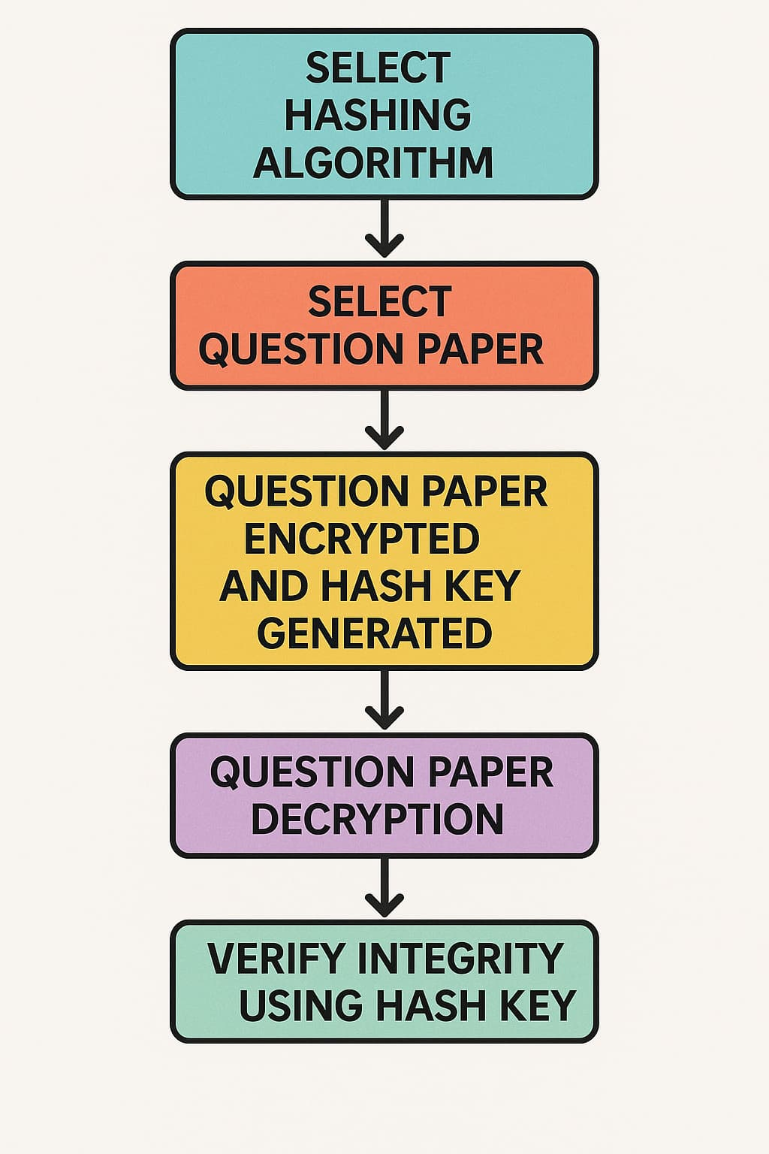
Flowchart of Module 2

Slide 11
MD5 Algorithm
1.MD5 (Message Digest Algorithm 5) is a widely used cryptographic hash function that produces a 128-bit (16-byte) hash value from data.
2.It is commonly used to verify data integrity by creating a digital fingerprint of a message or file.
Key Features
Fixed Output Size (128-bit)
Fast and Efficient
Not Secure for Cryptographic Use

Slide 12
MD5 Hashing Implementation
MD5 Algorithm
Hashing Process
Custom Interface
Understand the MD5 hashing algorithm.
Apply MD5 to the question paper.
Show the custom user interface for the
MD5 hash.

Slide 13
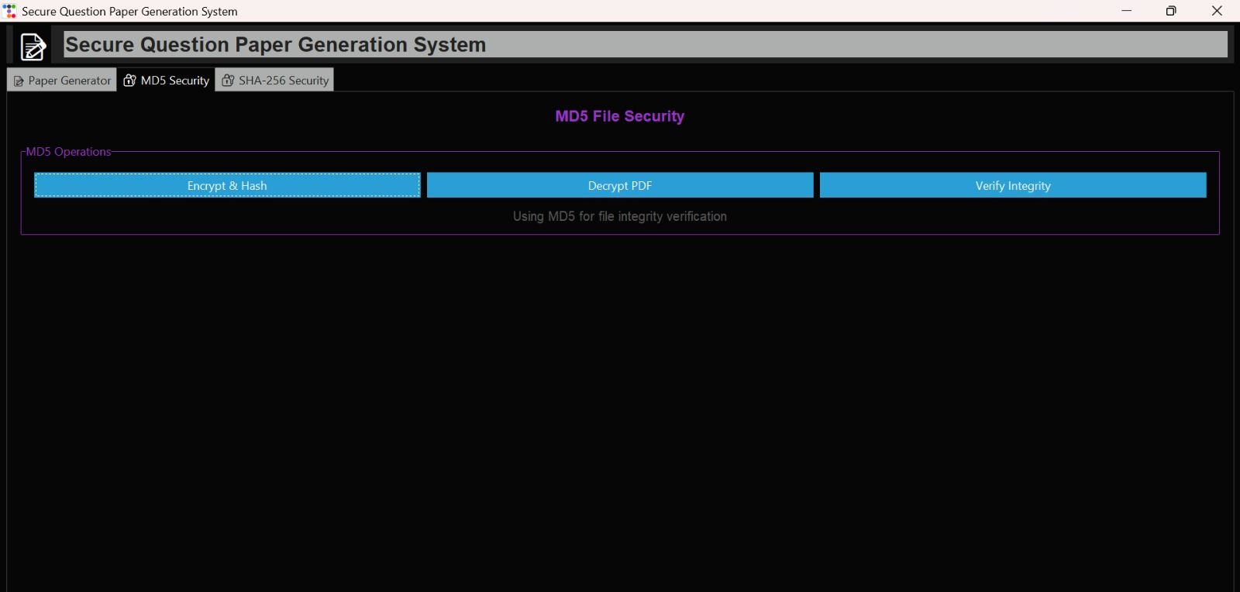

Slide 14
SHA 256 Algorithm
1.SHA-256 (Secure Hash Algorithm 256-bit) is a cryptographic hash function that belongs to the SHA-2 family, developed by the National Security Agency (NSA). It takes any input and produces a fixed 256-bit (32-byte) hash value, usually represented as a 64-character hexadecimal string.
2.It is widely used for data integrity, digital signatures, blockchain, and password hashing, due to its strong security properties.
Key Features:
Strong Security
Fixed Output Size
Widely Used
Slower but More Secure than MD5

Slide 15
SHA256 Hashing Implementation
SHA256 Algorithm
Hashing Process
Custom Interface
More secure than MD5.
Apply SHA256 to the paper.
Display interface for hash generation.
Security Module Workflow
1
Generate Paper
2
Generate Hash
3
Distribute Hash
4
Verify Integrity

Slide 16
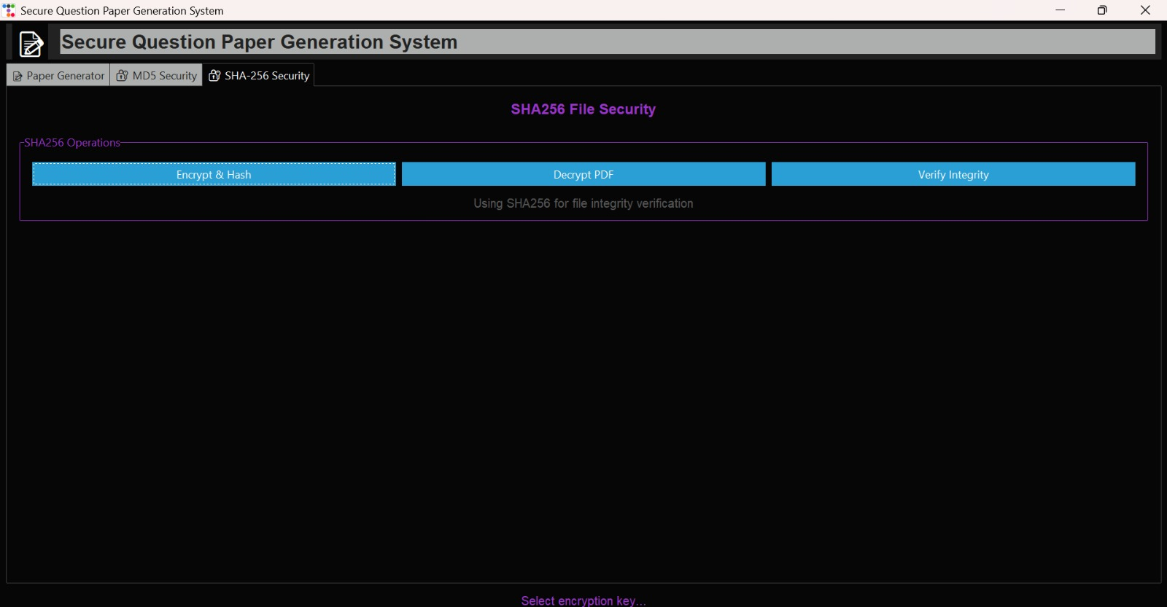

Slide 17
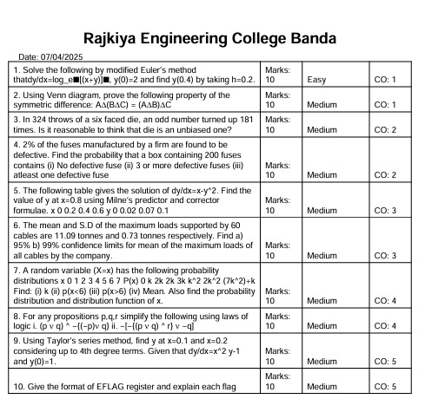

Slide 18
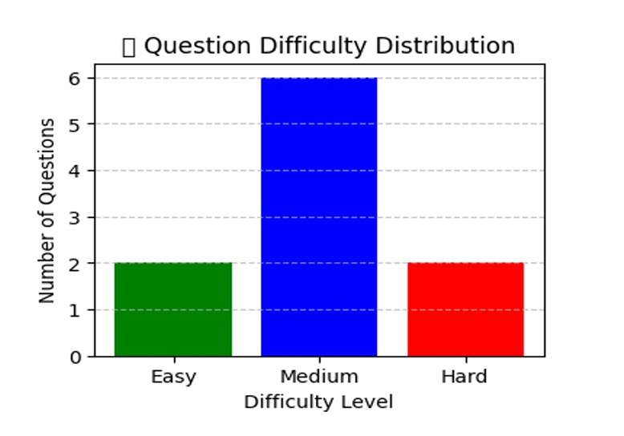

Slide 19
Comparison between MD5 and SHA256
 | MD5 | SHA256
Hash Size | 128-bit | 256-bit
Security | Low (vulnerable to collisions) | High (collision resistant)
Speed | Faster | Slower but secure
Usage | Checksums ,validations | Blockchain, digital signature

Slide 20
THANK YOU!

